Slide 1
Photocatalytic Water Splitting
——表面物理第一小组

Slide 2
Outline
Introduction
The basic mechanism
Photolysis in TiO₂
Optimization for photocatalytic activity
Conclusion

Slide 3
Introduction
Why Photocatalytic water splitting?
Water splitting: $H_{2}O\underset{→}{hυ}H_{2}+{\frac{1}{2}O}_{2}$
$H_{2}$: clean fuel——no pollution or green-house effect gas.
“$O_{2}$”: water/air purification——degrade and mineralize organics into ${CO}_{2}$ and harmless inorganic anions.
The principle may be used to make primary battery.
Photo: convert solar energy into chemical energy
Renewable
Environment friendly
Economic

Slide 4
For electrochemical decomposition of water, a potential difference more than 1.23V is needed.
This is equivalent to a photon of $λ\sim 1000$ nm (infrared light).
However, this reaction is kinetically very slow for$λ>$380 nm.
Due to the transparency of water to visible light, photolysis can only occur with $λ<$180 nm.
The photocatalysts are needed!

Slide 5
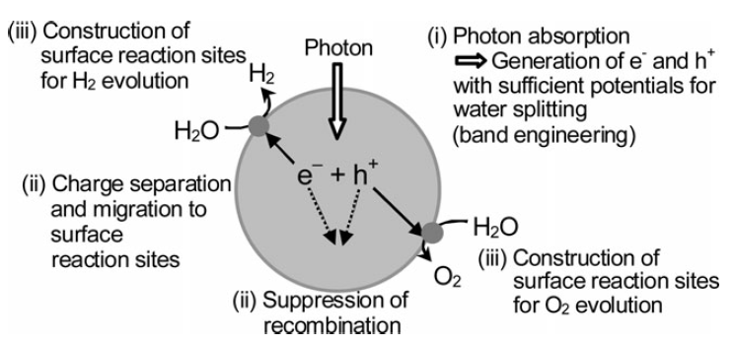
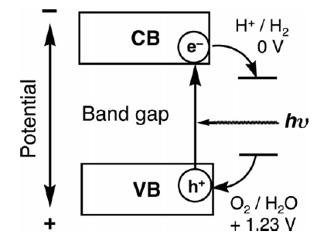
The basic mechanism
Main processes of photocatalytic water splitting:

Slide 6
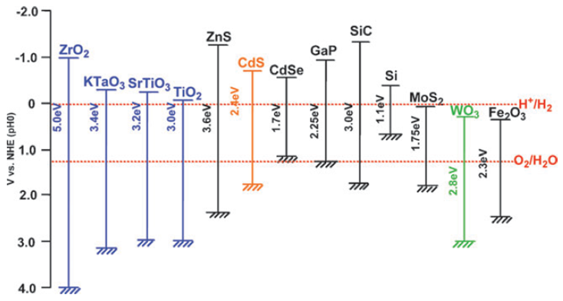
Requirements for photocatalysts
Difficulty to overcome
Recombination of $e^{−}−h^{+}$ pair
Fast drawback reaction
Inability to utilize visible light
Catalyst decay
Notes:
在太阳光中，可见光占很大一部分能量

Slide 7
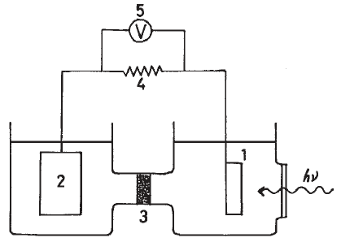
Photolysis in TiO₂
Advantages:
strong catalytic activity
high chemical stability (non-corrosive)
long lifetime of electron/hole pairs
Environmentally friendly
Abundant and cost effective.
$$\underset{→}{I}$$
$$\underset{←}{e^{−}}$$
Pt counter electrode
TiO₂ n-type photoelectrode
Honda–Fujishima effect
Notes:
最早实现；被广泛的研究。

Slide 8
Optimization
Difficulty and possible solution
Recombination of $e^{−}−h^{+}$ pair:
Co-catalyst to separate electron and holes
Chemical addition—electron/hole doner
Atomic layer deposition (ALD)—passivate surface states
Fast drawback reaction
Chemical addition
Inability to utilize visible light
Dye sensitization
Composition Semiconductor
Catalyst decay
Atomic layer deposition
Notes:
应用——优化
水的光解包括产氢，产氧和全分解。这里主要介绍关于产氢的方法。
在全分解中，产氧为控速步骤。

Slide 9
Co-catalyst: Noble metal loading
The Fermi levels of some noble metals (Pt, Au, Pd, Rh, Ni, Cu and Ag) are lower than that of TiO₂.
Conduction band of TiO₂ $\underset{→}{\text{Photo}\text{−}\text{excited} \text{electrons}}$metal particles
Photo-generated holes remain on the valence band TiO₂.
Reduce the possibility of recombination.
Drawback:
Too much metal particle might reduce photon absorption by TiO₂
Become electron-hole recombination centers.
Dual cocatalysts: coloading of both H₂/O₂ evolution cocatalysts
Notes:
随着电子的转移金属的费米能级也被提高，进而可以催化产氢。
同时负载氢和氧可以进一步分离电子/空穴，提高反应效率

Slide 10
Addition of electron donor(for H₂)
Adding electron donors (sacrificial reagents or hole scavengers) to react irreversibly with the VB holes.
Organic compounds(hydrocarbons)
Enhancement capability: EDTA$>$methanol$>$ethanol$>$lactic acid
Decomposition of pollutants and production of clean hydrogen fuel
Inorganic ions
IO₃⁻/I⁻, S²⁻/SO₂³⁻and Ce⁴⁺/Ce³⁺……

Slide 11
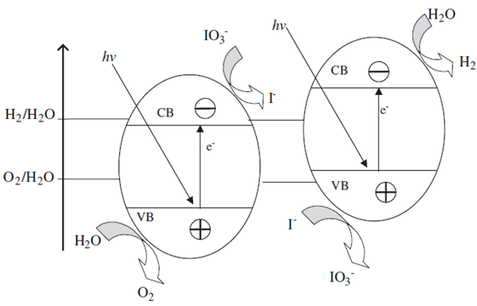
Z-scheme system
Semiconductors with suitable band positions are rare
Redox power is weakened by band-gap narrowing
A wider range of visible light utilization
Strong oxidation and reduction ability
Undesirable recombination of electrons and holes can be inhibited
The reverse reactions to regenerate H₂O can be efﬁciently suppressed

Slide 12
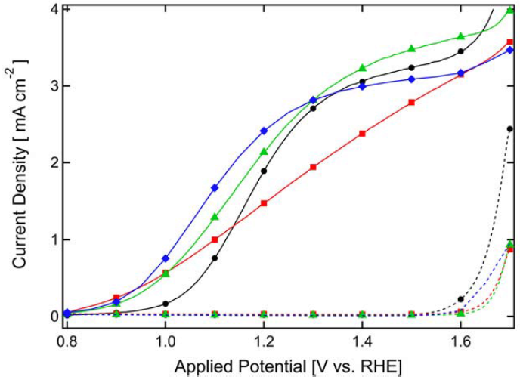
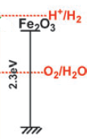
Atomic layer deposition
Theoretically, minimizing the particle of photocatalyst can reduce the time of electron/hole separation and increase the surface area and gas desorption.
Surface recombination and surface trapping states!
Hematite ($α$-Fe₂O₃): inexpensive but large overpotential.
Current densities of the prepared photoanode
Broken lines: in dark
Solid line: under simulated solar illumination
Black: before ALD
Red: after ALD (Al₂O₃)
Green: annealing at 300$℃$ 20 min
Blue: annealing at 400 $℃$ 20 min
Notes:
表面态的存在导致α-Fe2O3光电极拥有较大的反应过
电位

Slide 13
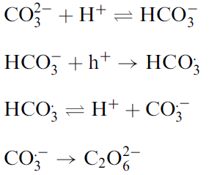
Chemical addition: suppress backward reaction
Na₂CO₃ was found to be beneficial for hydrogen and oxygen production in various semiconductor photocatalysts.
holes were consumed to form carbonate radical.
Promote desorption of O₂
minimize the formation of H₂O from the backward reaction
Notes:
空穴和碳酸盐生成碳酸盐根阴离子自由基，促进电子空穴对分离
自由基生成氧气和二氧化碳，促进氧气的脱附，减少逆反应

Slide 14
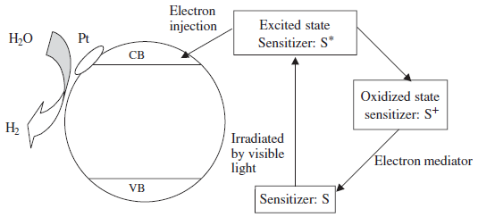
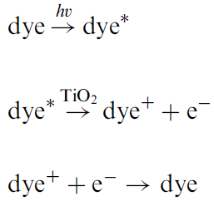
Dye sensitization
Dyes: redox property and visible light sensitivity
Efficient absorption of visible light and transfer of electrons from excited dyes to the CB of TiO₂.
To regenerate dyes, redox systems or sacrificial agents are needed to sustain the reaction cycle.
Notes:
染料敏化

Slide 15
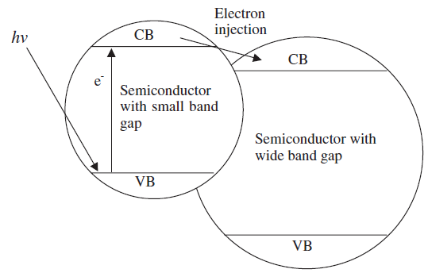
Composite semiconductors
A large band gap semiconductor is coupled with a small band gap semiconductor.
Better charge separation.
Sacrificial agent has to be added

Slide 16
Conclusion
The mechanism of photo-catalysis.
Strategies to improve photocatalytic activity:
Enhancing visible light harvesting
Boosting the separation and migration of photogenerated charge carriers
Loading efficient cocatalysts for H₂ and/or O₂ evolution
Synergistic investigation of above strategies are needed.
Deeper understanding of the kinetics and dynamics of a photocatalytic reaction should is necessary to establish rational strategies.
Notes:
1.染料敏化 复合窄带半导体
2.复合半导体（分离电子空穴），改变反应过程（两个半反应）
3.助催化剂：贵金属等

Slide 17
Thank you!

